Slide 1

Mobile Sales Performance: Tracking & Analysis
Understanding mobile sales trends is critical for business growth. This presentation guides sales managers, marketing analysts, and executives through monitoring and optimizing mobile sales across products and regions.
AG
by Anushka Gupta

Slide 2
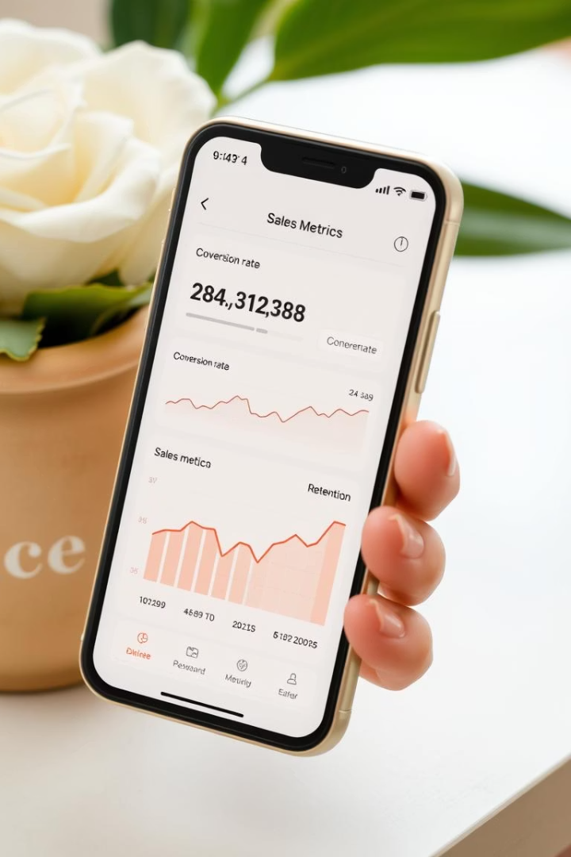
Key Metrics for Mobile Sales Tracking
Total Sales
Revenue
The total number of completed transactions or mobile phones sold.
The total income generated from selling mobile phones, before deducting costs or expenses.
Units Sold
The total quantity of mobile phones sold over the selected time period.

Slide 3
Mobile Sales Performance by Product Category
Sales Volume & Revenue
Top Sellers & Trends
Assess revenue and volumes by mobile product categories.
Identify leading products and analyze their performance over time.

Slide 4
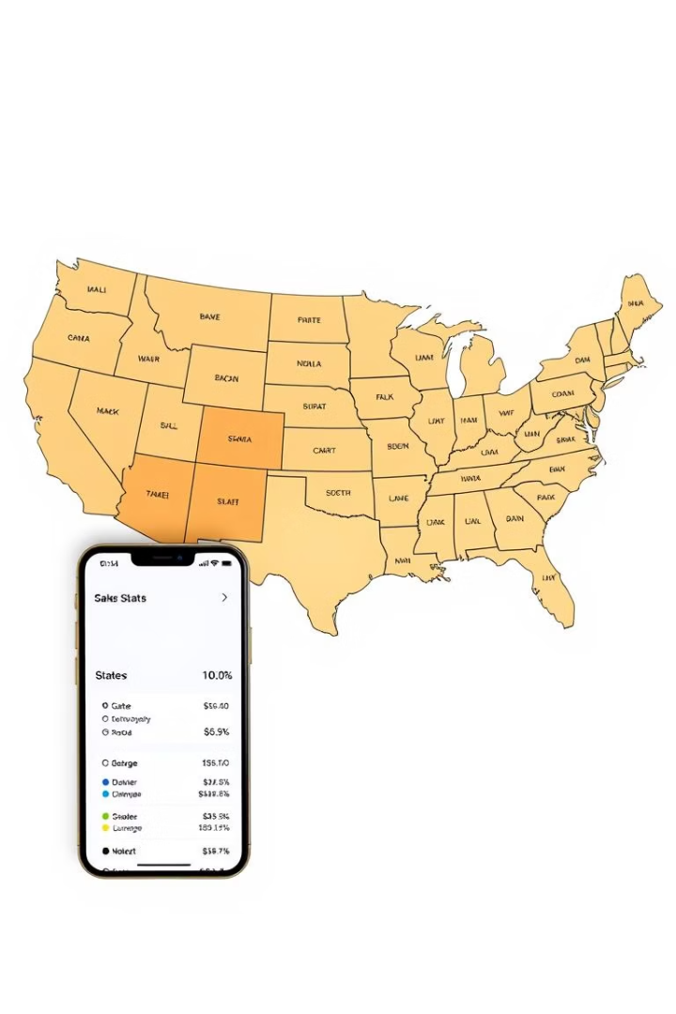
Regional Analysis of Mobile Sales
Sales Distribution
Top Regions & Drivers
Understand how mobile sales spread across various geographic areas.
Explore factors enabling success in high-performing markets.

Slide 5
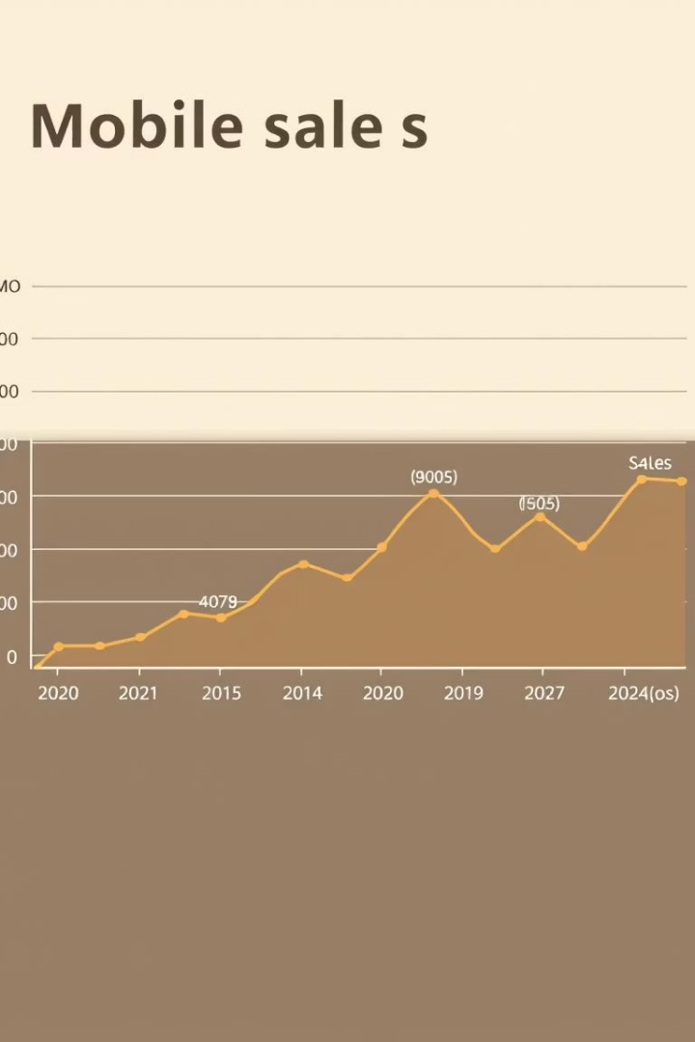
Time-Series Analysis of Mobile Sales Data
1
Trends & Patterns
Review month-over-month, year-over-year sales and seasonal effects.
2
Event Impacts
Analyze sales impacts during holidays and major events.
3
Forecasting
Predict future sales using historical and external factor correlations.

Slide 6





Conclusion: Actionable Insights and Recommendations
Key Findings
Summarize mobile sales trends and valuable insights.
Recommendations
Suggest data-driven strategies to enhance mobile sales.
Next Steps
Implement tracking, refine analysis, and optimize sales efforts.
Continuous Monitoring
Emphasize ongoing adaptation for sustained performance.

